Slide 1

Lecture 4
Functions

Slide 2

Agenda
Functions Overview
Writing Functions
Using Functions
Why Using Functions?
Best Practices
Variable Scopes
Pass-by-Value & Pass-by-Reference

Slide 3
Functions Overview

Slide 4

Function
A piece of packaged code
A programming component that perform a specific task
An encapsulation of a piece of repeatedly used code
In some other languages/scenarios, it is named as “Method”, “Procedure”, “Subroutine”

Slide 5
How Function Works
Functions:
a
Weight
Add
a + b
name
SayHello
(Print Hello {name})
Calculate BMI
BMI
Height
b
Main Program (BMI Calculator Program):
Start
Ask for User’s Name
SayHello
(Print Hello {name})
Ask for User’s Weight & Height
Weight
Calculate BMI
name
BMI
Height

Slide 6
Writing Functions

Slide 7
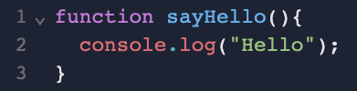
Let’s Write Some Functions
(WITHOUT Input, WITHOUT Returning Value)
sayHello
(Print Hello)
JS Code
Diagram View

Slide 8
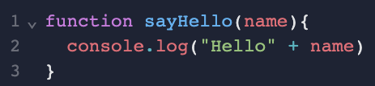
Let’s Write Some Functions
(WITH Input, WITHOUT Returning Value)
name
sayHello
(Print Hello {name})
JS Code
Diagram View

Slide 9

Let’s Write Some Functions
(WITH Input, WITH Returning Value)
a
Add
a + b
b
JS Code
Diagram View

Slide 10
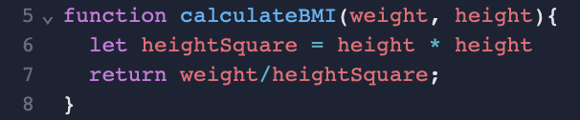
Let’s Write Some Functions
(WITH Input, WITH Returning Value)
Weight
Calculate BMI
BMI
Height
JS Code
Diagram View
Note: BMI = weight (kg) ÷ height² (m)

Slide 11
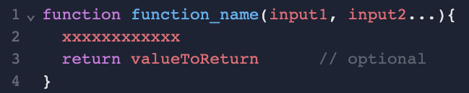
How to build a function?
input1
function_name
(xxxxxxxx)
valueToReturn
(Optional)
input2
JS Code
Diagram View

Slide 12
Using Functions

Slide 13
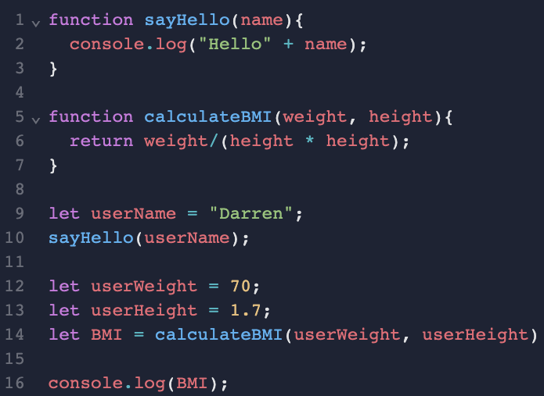
Let’s Use Some Functions
Functions:
Weight
name
SayHello
(Print “Hello” {name})
Calculate BMI
BMI
Height
Main Program:
Start
SayHello
Hello {name}
Weight
Calculate BMI
name
BMI
Height
console.log()

Slide 14
Why using functions?

Slide 15
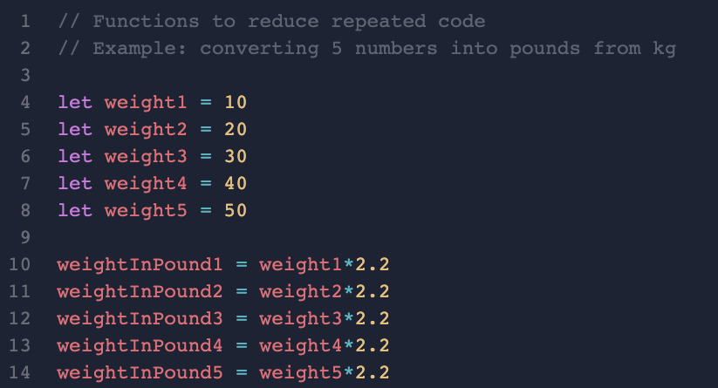
Why building function?
Notes:
// Functions to reduce repeated code
// Example: converting 5 numbers into pounds from kg
var weight1 = 10
var weight2 = 20
var weight3 = 30
var weight4 = 40
var weight5 = 50
weightInPound1 = weight1*2.2
weightInPound2 = weight2*2.2
weightInPound3 = weight3*2.2
weightInPound4 = weight4*2.2
weightInPound5 = weight5*2.2

Slide 16
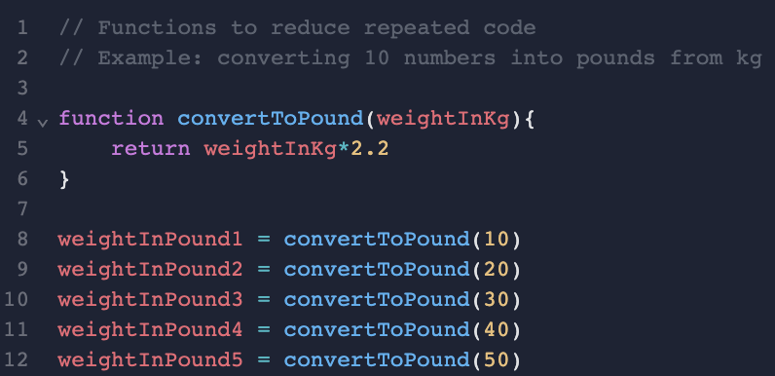
Why building function?

Slide 17
Best Practices

Slide 18
function_name
It should be a description of what the function do
e.g “convertToPound”, “CalculateTaxiFare”, “PrintHelloWorld” etc
it should be meaningful and human-readable
Bad Examples:
  calculate
  convert
  printReport

Slide 19
input/parameter/arguments
Can have virtually unlimited parameters (read this if you want to know more.)
Again, it should be human-readable and meaningful
e.g. weightInKg, name, age, etc
Bad Examples:
  Input1
  Weight1, weight2, weight3

Slide 20
Return Value
Optional for JavaScript
If your function is named as convertToPounds, the return value should be the resulting number in pounds

Slide 21
Variable Scopes

Slide 22
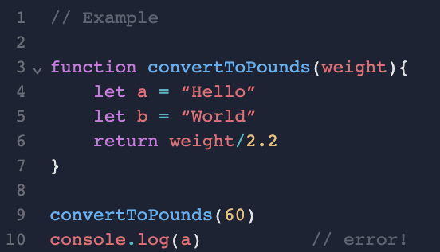
Local Scope
What is created in the function could not be accessed outside of the function

Slide 23
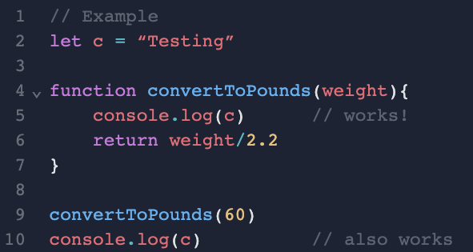
Global Scope
What is created outside of the function could be accessed inside of the function

Slide 24
Pass-by-Value & Pass-by-Reference

Slide 25
Pass-by-Value vs Pass-by-Reference
Pass-by-Value = Copying the value to the function
  No matter what happened in the functions, no impact to the original variable at all
Pass-by-Reference = Passing the actual object to the function
  making changes in the function to the variable, the original variable will get changed as well

Slide 26
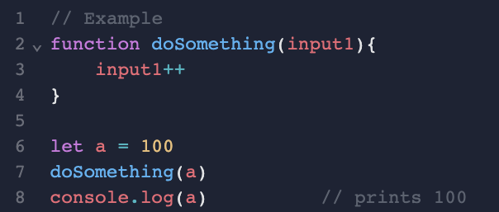
Pass-by-Value
In Javascript, if you pass a primitive type(string, number, boolean, undefined, null) to a function, it makes a new copy
i.e. the original variable is untouched

Slide 27
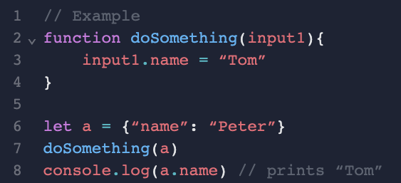
Pass-by-Reference
In Javascript, if you pass an object or array to a function, it would be pass-by-reference
i.e. the original variable would be changed

